Slide 1
Lecture 2 Nature, Spirituality and Conservation
I.Definition of Wilderness in 1964 American Wilderness Act
II.Wilderness perception before American transcendentalism
III.American transcendentalism and wilderness
IV.Romanticism and Wilderness Appreciation
V.Philosophical Arguments for Preservation of Wilderness

Slide 2
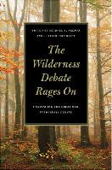
Lecture 2 Nature, Spirituality and Conservation
I.Definition of Wilderness in 1964 American Wilderness Act
II.Wilderness perception before American transcendentalism
III.American transcendentalism and wilderness
IV.Romanticism and Wilderness Appreciation
V.Philosophical Arguments for Preservation of Wilderness

Slide 3
I. 1964 Wilderness Act
[A]n area of undeveloped Federal land retaining its primeval character and
influence, without permanent improvements or human habitation, which is
protected and managed so as to preserve its natural conditions and which (1)
generally appears to have been affected primarily by the forces of nature, with
the imprint of man's work substantially unnoticeable; (2) has outstanding
opportunities for solitude or a primitive type of recreation; (3)
has at least five thousand acres of land or is of sufficient size to make
practicable its preservation and use in an unimpaired condition; and (4) may
also contain ecological, geological, or other features of scientific, educational,
scenic, and historical value.

Slide 4
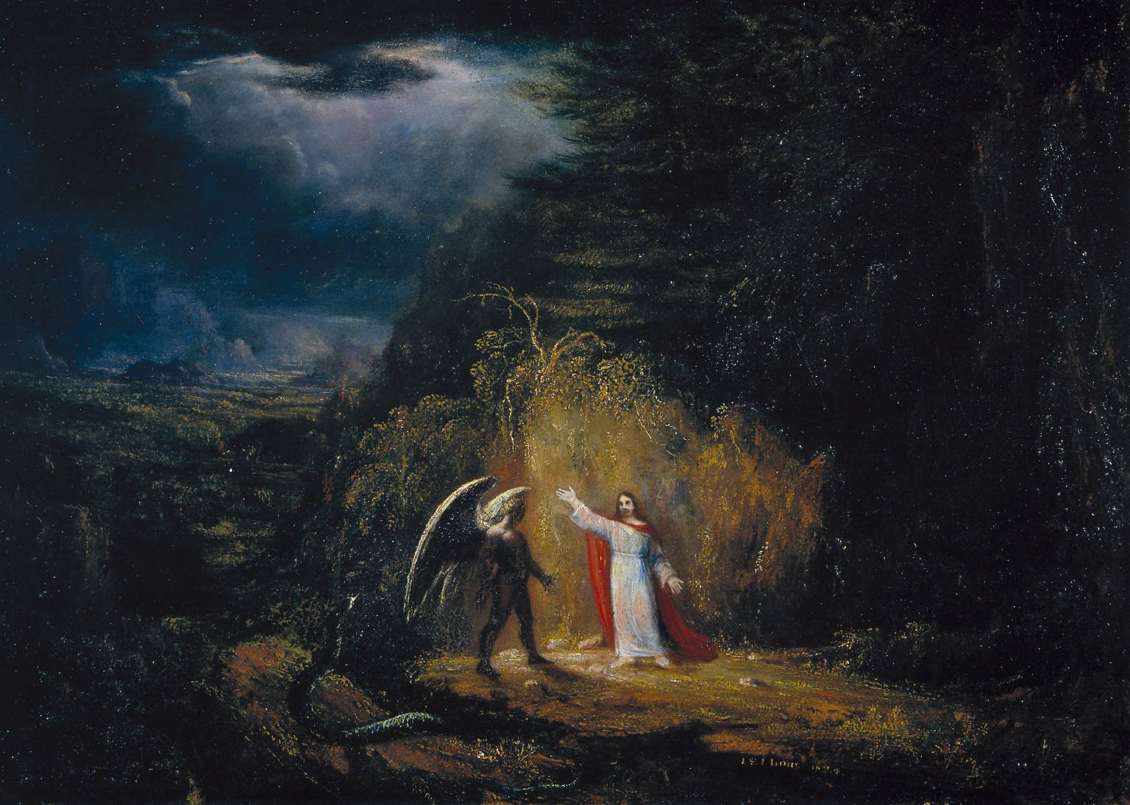
II. Wilderness perception before American transcendentalism(1)Religion
John Winthrop “Howling Wilderness”
1. The first governor of the Massachusetts Bay Colony
2. The Bible shaped the Puritan’s worldview.
3. They used the word “wilderness” to evoke the world after the Fall from the Garden of Eden, as Adam and Eve found themselves in a wilderness.
4. Widerness is characterized by chaos, danger, and evil.

Slide 5
II. Wilderness perception before American transcendentalism(2): Private Property Rights
“As much land as a man tills, plants, improves, cultivates, and can use the product of, so much is his property. He by his labor does, as it were, exclude it from the common. […] God and his reason commanded him to subdue the earth, i.e., improve it for the benefit of life, and therein lay out something upon it that was his own, his labor […] thereby annexed to it something that was his property” (John Lock, Second Treatise of Civil Government (1690)
Reasons for mass European migration to North America
(1)Religions and political prosecution
(2)There was no land aristocrcy

Slide 6
III. Wilderness perception before American transcendentalism(3): Wood Resources
(1) Wilderness was an aberration to be erased, an obstacle to be overcome.
(2) From early 17th century to 1850, it is estimated that 114 million acres of forest were cleared in the United States.
(3)Before English settlements, New England was 95% forested. After that, it is estimated that Massachusetts had cleared about 60% of its forests.

Slide 7
American transcendentalism and Wilderness
1. Idealistic philosophical and social movement that developed in New England around 1836. The main figures are Emerson and Henry David Thoreau (1817-1862)
2. It can be seen as a late American version of Romanticism, which is in opposite to rationalism. They stress emotions and poetic imagination.
3. Transcendentalist thinkers tend to distance themselves from the blind faith in progress, mostly in the name of wilderness and the protection of wild nature.
4. Transcendental Club

Slide 8

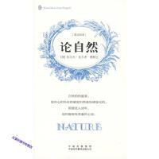
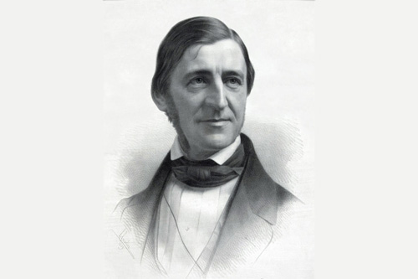
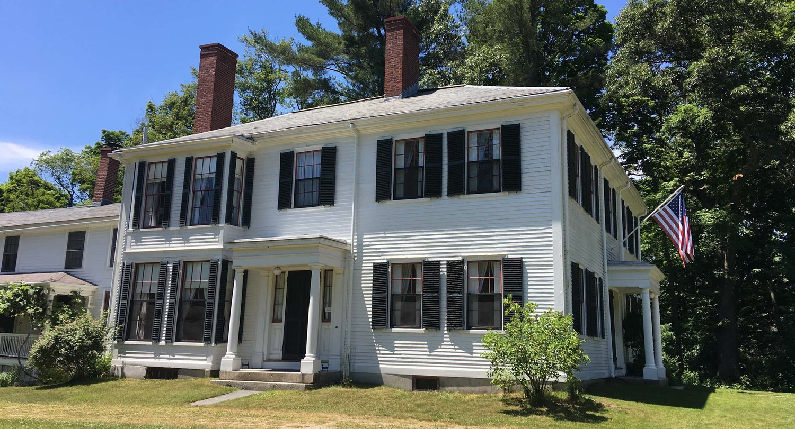

Emerson and Transcendentalism

Slide 9
Emerson and Transcendentalism
Cause and Effect; Innate Universal Laws
“We are natural believers. Truth or the connection of cause and effect alone interests us. We are persuaded that a thread runs through all things: all worlds are strung on it as beads: and men and events and life come to us only because of that thread: they pass and repass only that we may know the direction and continuity of that line. A book or statement which goes to show that there is no line, but random and chaos; a calamity out of nothing, a prosperity and no account of it, a hero born from a fool, a fool from a hero,---dispirits us. Seen or unseen, we believe the tie exists.”

Slide 10
Emerson and Transcendentalism
“There are but two things, or but one thing&its shadow---Cause&Effect, and Effect is itself worthless if separated from Cause. It is Cause still that must be worshipped in Effect; so that it is only one thing. The worship of Effect is Idolatry. The Church including under the name, Doctrine, Forms, Discipline, Members, is the instant Effect: Weak man adheres to the Effect&lets God go.”
“Our dealing with sensible objects is a constant exercise in the necessary lessons of difference, of likeness,of order, of being and seeming, of progressive arrangement; of ascent from particular to general; of combination to one end of manifold forces.”

Slide 11
Emerson and Transcendentalism
“The moral sentiment is that which may be called the Universal Mind, for it is absolute&in every individual the law of the world.”
“Arising out of eternal Reason, one and perfect, whatever is beautiful rests on the foundations of the necessary.”
“Therefore, let no man glory in men; for all things are yours”, that “it is the proper business of life to learn ourselves, for in so doing we discover the ultimate standard of character and the ultimate source of empowerment.”

Slide 12

III.American transcendentalism and wilderness

Slide 13
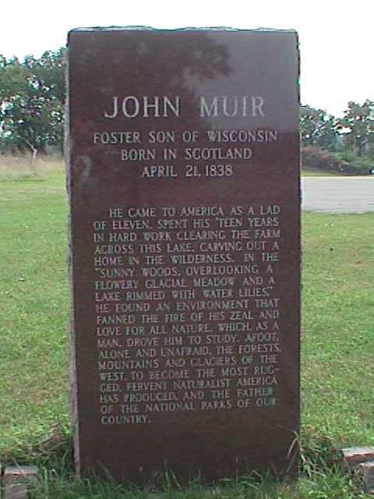
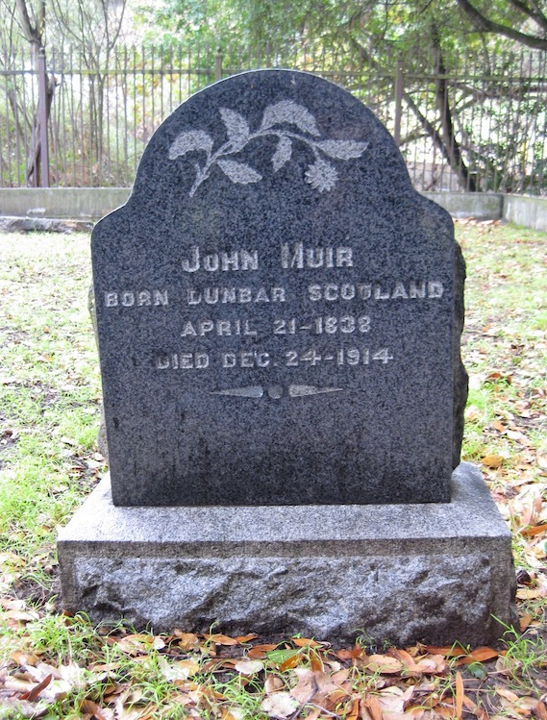
John Muir

Slide 14
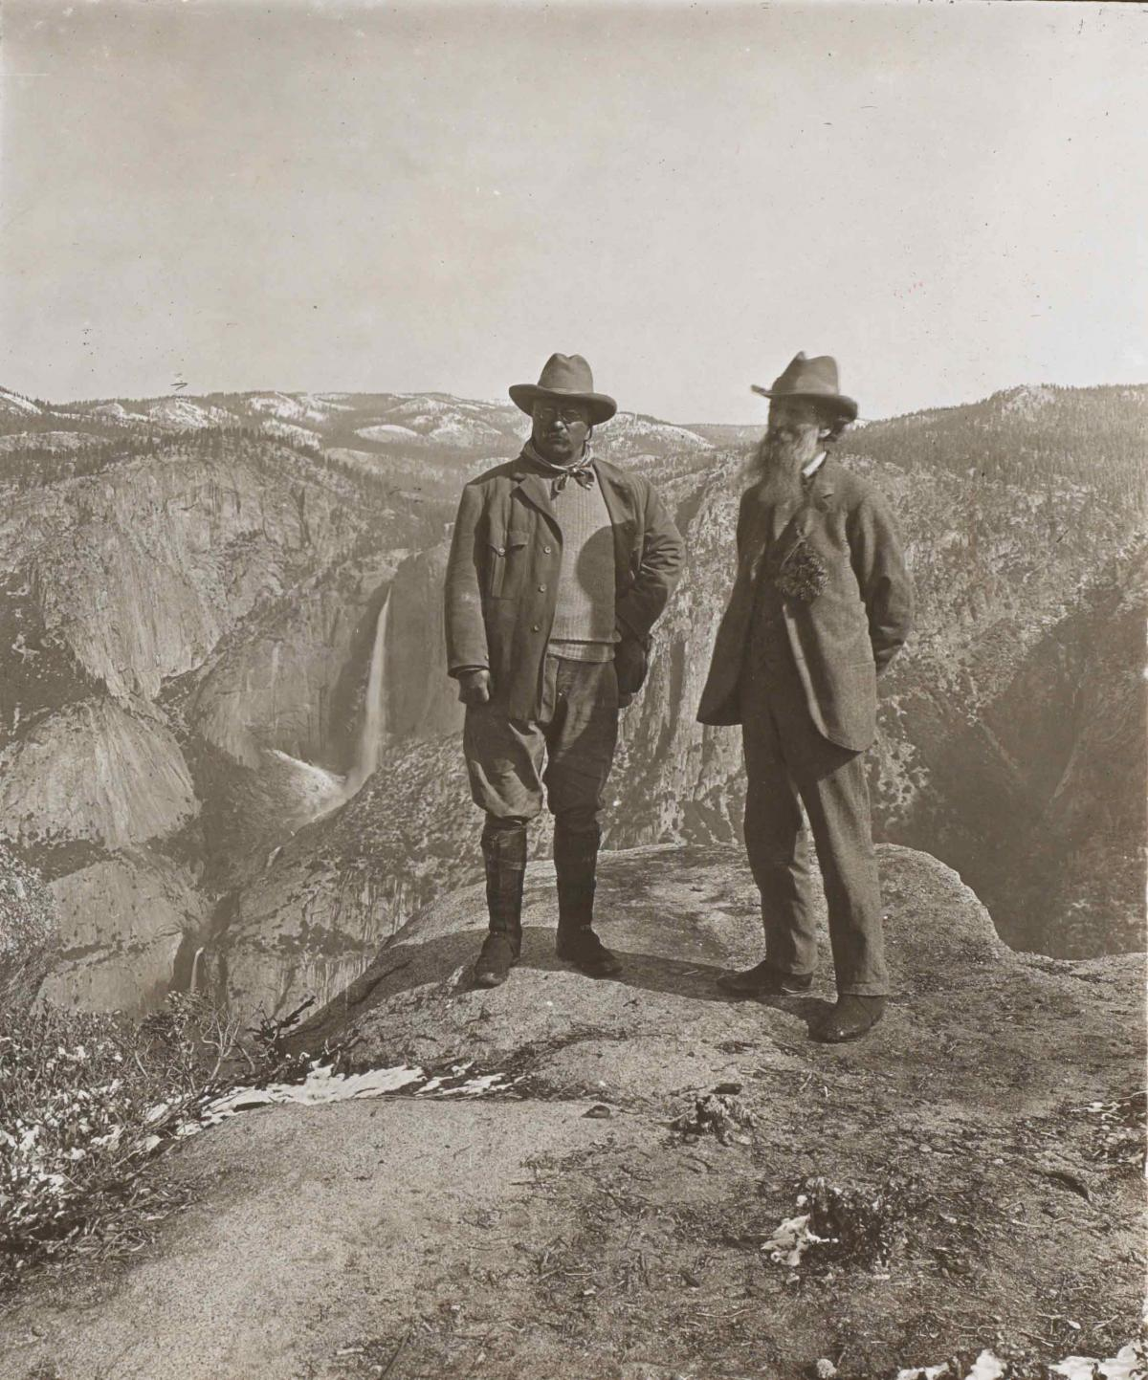

Slide 15
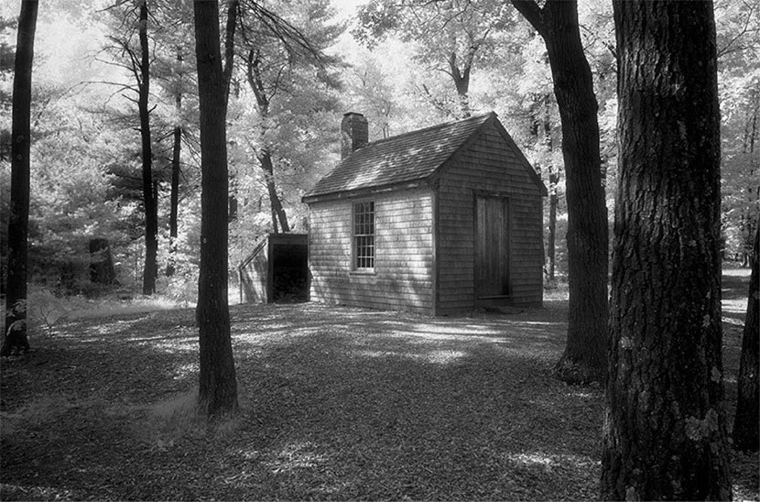
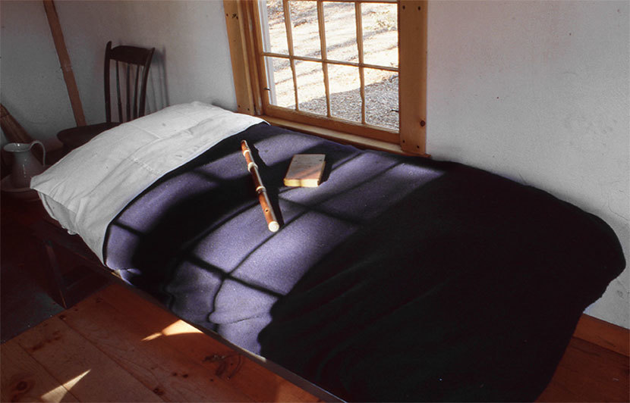
梭罗：《瓦尔登湖》

Slide 16
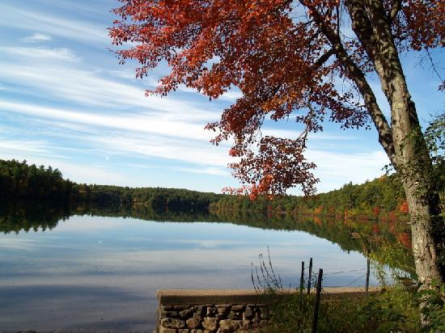
Henry David Thoreau (1817-1862)
He is American author,naturalist and a giant of American literature. And his books include Walden and Civil Disobedience

Slide 17
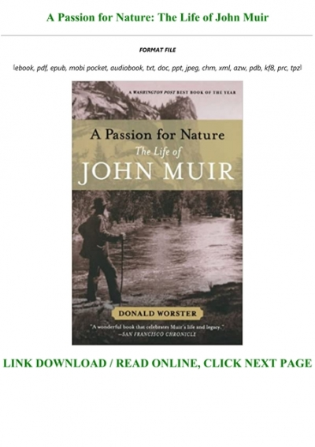
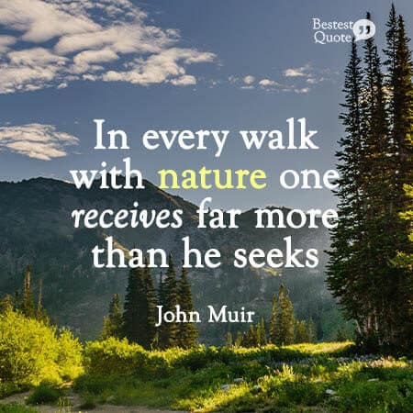
John Muir and Wildernss Preservation

Slide 18
Walden: The Art of Living
Pristine nature can provide us with an ideal place where we can make good ethical judgement; “I love to be alone. I never found the companion that was so companionable as solitude...Society is commonly too cheap. We meet at very short intervals, not having had time to acquire any new value for each other.”
The beauty of Pristine nature and the beauty of justice are similar.

Slide 19
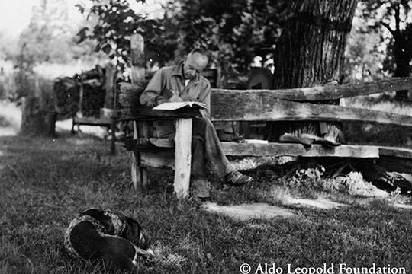
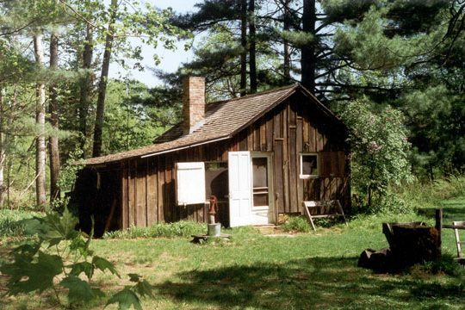
Aldo Leopold: Land Ethics

Slide 20

《沙乡年鉴》
主要思想：
大地伦理思想的提出。
生态科学和生态审美思想。

Slide 21
Romanticism and Wilderness
1.Wilderness versus Civilization
Discourse on the Sciences and the Arts and Discourse on the Origin of Inequality
(1)He questioned the absolute authority and value ascribed to the arts and science in the age of the Enlightenment and argued that they in fact cause the human beings’ moral degeneration.
(2)Modern society and political life lead to an excessive inequality among human beings that decadence and unhappiness are the hallmarks of human society.

Slide 22
Rousseau: Romanticism and Wilderness
Wilderness versus Civilization
Discourse on the Sciences and the Arts and Discourse on the Origin of Inequality
(1)He questioned the absolute authority and value ascribed to the arts and science in the age of the Enlightenment and argued that they in fact cause the human beings’ moral degeneration.
(2)Modern society and political life lead to an excessive inequality among human beings that decadence and unhappiness are the hallmarks of human society.

Slide 23
Rousseau: Romanticism and Wilderness
Wilderness, Primitive State and Savage Human
(1)They live in the forests with no fixed dwelling and they live a solitary and self-reliant life.
(2)Savage Man was physically robust and agile. They don’t have any sophisticated technology and their bodies were their sole tool. Self-preservation is its sole concern.
(3)Savage men don’t have emotional or social bond between human beings and an complete indifference to fellow beings is the order of the day. It is in contrast with the Aristotle who stated in the Politics that social instinct is implanted in all men by nature.

Slide 24
IV. Rousseau: Romanticism and Wilderness
1.Wilderness versus Civilization
Discourse on the Sciences and the Arts and Discourse on the Origin of Inequality
(1)He questioned the absolute authority and value ascribed to the arts and science in the age of the Enlightenment and argued that they in fact cause the human beings’ moral degeneration.
(2)Modern society and political life lead to an excessive inequality among human beings that decadence and unhappiness are the hallmarks of human society.

Slide 25
IV. Rousseau: Romanticism and Wilderness
1.Wilderness versus Civilization
Discourse on the Sciences and the Arts and Discourse on the Origin of Inequality
(1)He questioned the absolute authority and value ascribed to the arts and science in the age of the Enlightenment and argued that they in fact cause the human beings’ moral degeneration.
(2)Modern society and political life lead to an excessive inequality among human beings that decadence and unhappiness are the hallmarks of human society.

Slide 26
IV. Rousseau: Romanticism and Wilderness
Savage Man’s transformation from Wilderness to Civilization
(1)The First Stage: Metallurgy and agriculture are the starting point for the degeneration of Savage Man. In this sage, conjugal and parental love, the division of labour among the sexes and the decrease of physical strength given the emergent element of cooperation.The most fateful change is the loss of self-sufficiency and people at this stage is increasingly in need of others’ help for its daily life.
(2)The Second Stage: Establishment of Private Property. The right to unilise a piece of land temporarily turns into a permanent right to do. People who are capable of sophisticate reasoning, forethought and abstract language become the rich or the ruling class, which cause the incessant state of war between the rich and the poor. The powerful started to convince the poor that the war can be terminated by a social contract.

Slide 27
V. Philosophical Arguments for Preservation of Wilderness (Michael P. Nelson)
1.The Natural Resource Argument; The Hunting Argument;The Pharmacopoeia Argument; The Service Argument; The Life-Support Argument; The Physical Therapy Argument;
2.The Arena Argument;The Mental Therapy Argument; The Art Gallery Argument
3.The Inspiration Argument; The Cathedral Argument; The Laboratory Argument
4.The Standard of Land Health Argument;The Classroom Argument;The Ontology Argument
5.The Cultural Diversity Argument; The National Character Argument
6.The Self-Realization Argument; The Salvation Freedom argument; The Defense of Democracy Argument; The Social Bonding Argument; The Animal Welfare Argument
7.The Unknown and indirect benefit argument

